Slide 1
Introduction to NLP

Slide 2
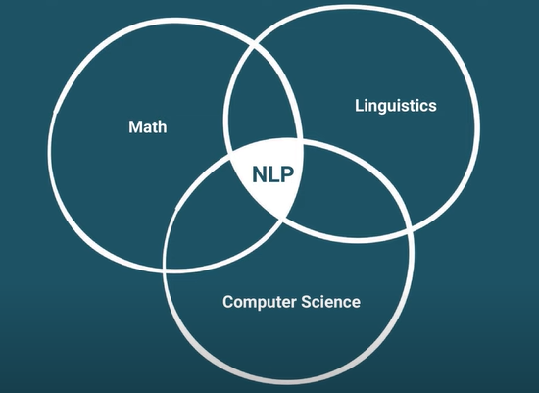
Natural Language Processing or NLP is a multidisciplinary field combining math linguistics and computer science the goal is to get computer to do useful things with natural language data. And by Natural language we mean the language we read , write and speak with.

Slide 3
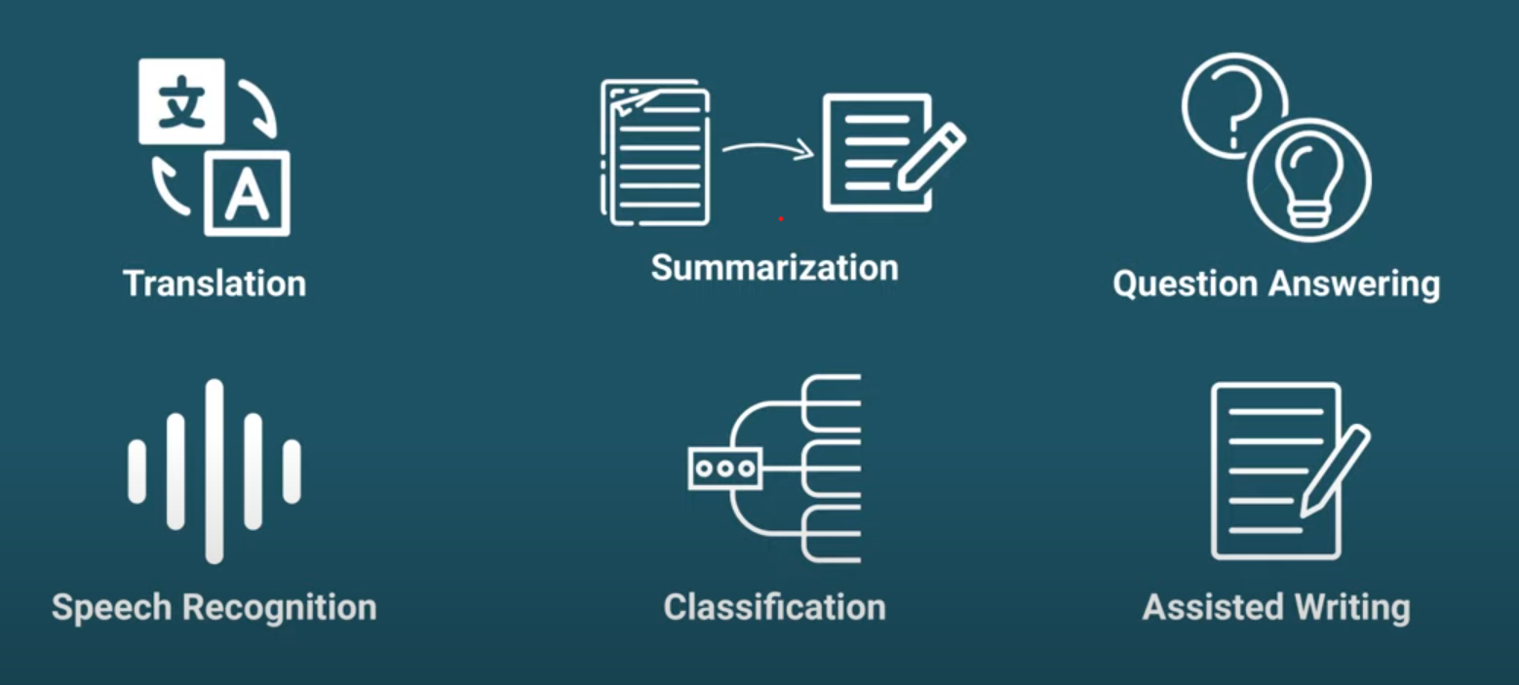
Common NLP Tasks and Applications

Slide 4

Why NLP is hard ?
NLP is dependent on natural language and its is evolving with us regularly. So it is highly Contextual and full of ambiguity, metaphors and expressions. For example…
He is at bank
Some reasons of why NLP is hard :
1.Context
2.Inflections
3.Content
4. Misspelled or misused words
5. Physical gestures

Slide 5
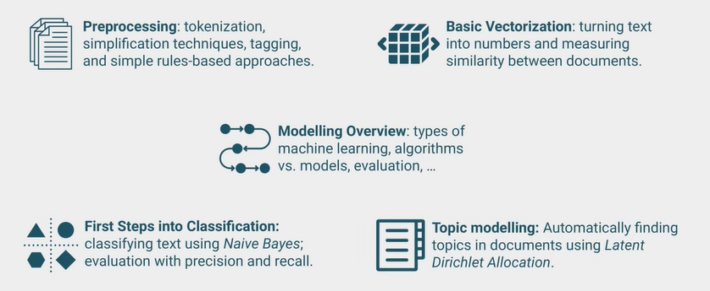
Fundamentals of NLP

Slide 6
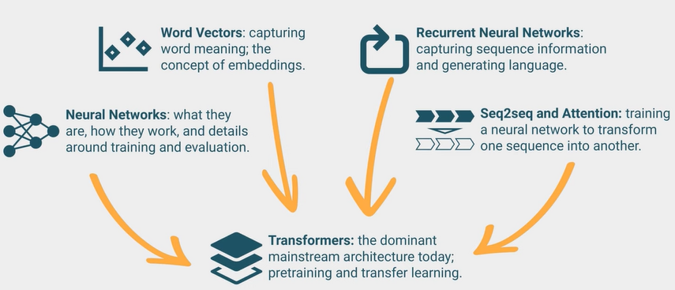
Deep Learning for NLP

Slide 7
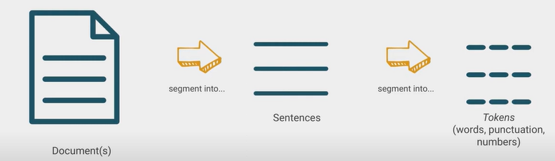
Preprocessing : 1.Tokenization
We start any NLP project with a data set its called corpus(unstructured). It can be …
1.Collection of posts we scraped from social media
2.Full books
3. Audio of pod casts etc.
Our first task is to preprocess this corpus to give it some structure for further analysis. Typically for NLP the first preprocessing step is tokenization
The process of segmenting our documents into tokens is called tokenization .

Slide 8
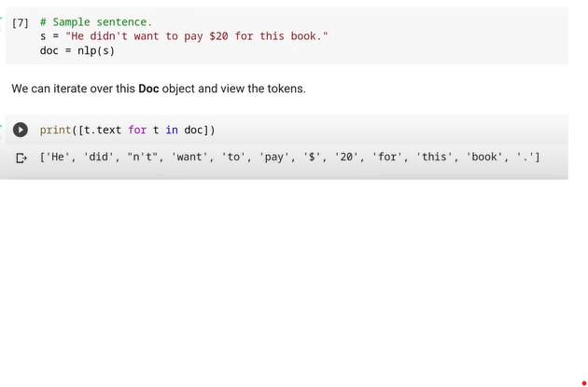
How to do tokenization
First need to import important libraries and a Small model to start our tokenization . We can do that with following code ..
()!pip install -U spacy==3.*
()!python -m spacy info
()import spacy
()!python -m spacy download en_core_web_sm
()nlp = spacy.load('en_core_web_sm’)
()type(nlp)
Next we can test tokenization with a sample text …

Slide 9
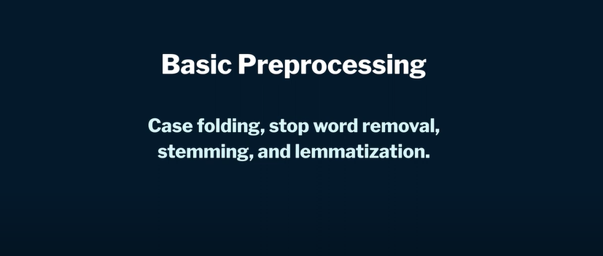

Slide 10
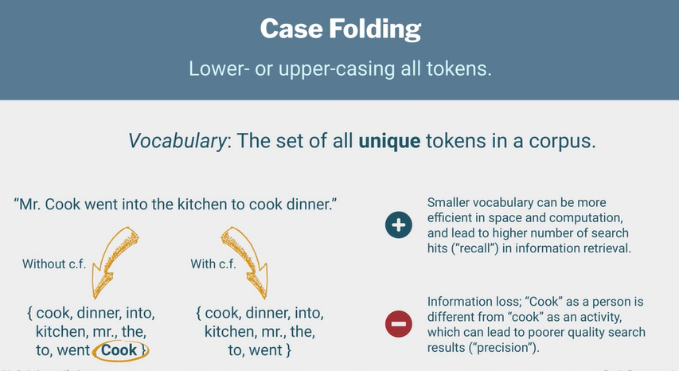

Slide 11
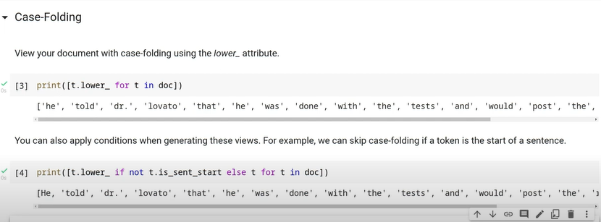
Code implementation of Case folding

Slide 12
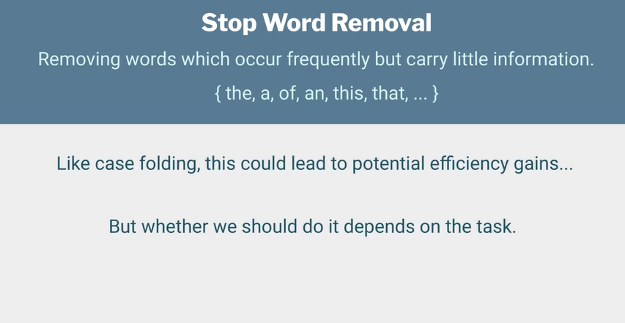

Slide 13
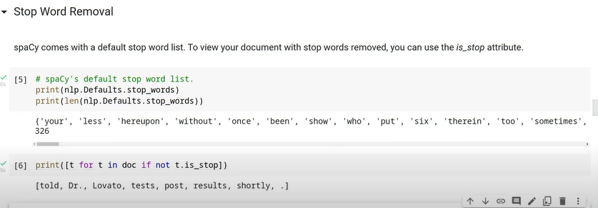
Code implementation of Stop Word Removal

Slide 14
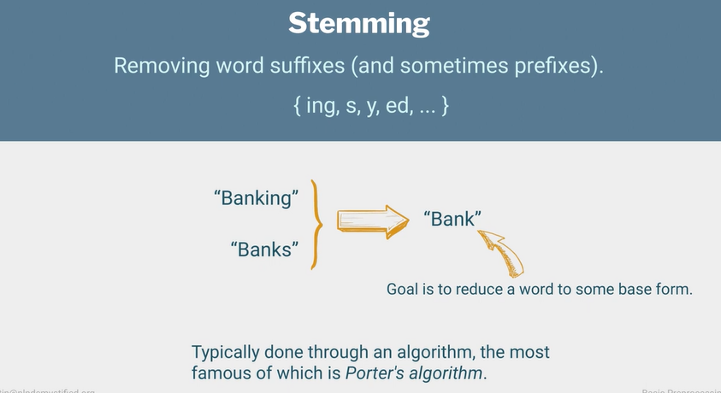

Slide 15
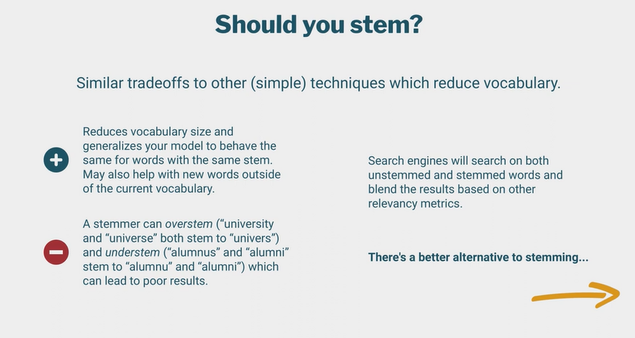

Slide 16
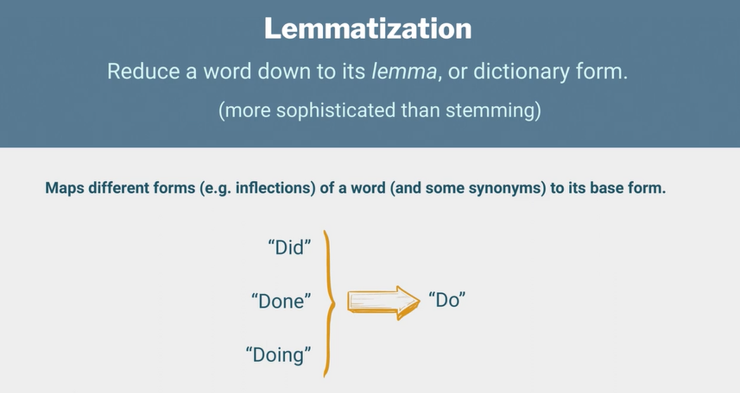

Slide 17
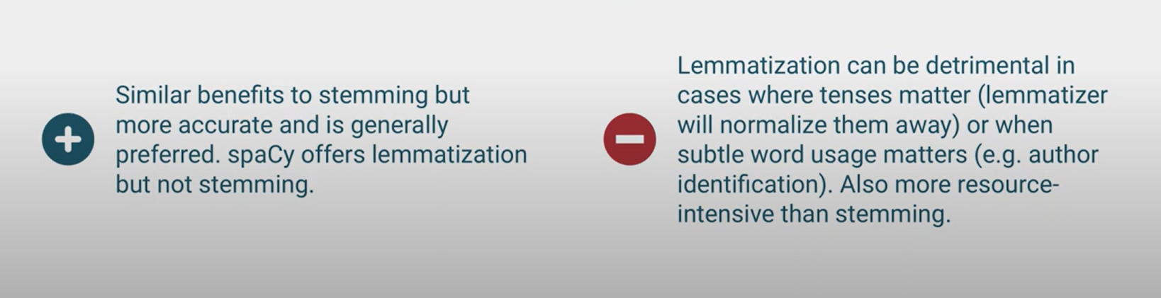
Tradeoffs of Lemmatization

Slide 18
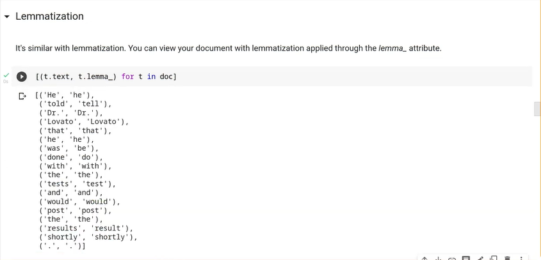
Code implementation of Lemmatization

Slide 19
Advanced Preprocessing
Prat-of-speech tagging
Named entity recognition and parsing

Slide 20
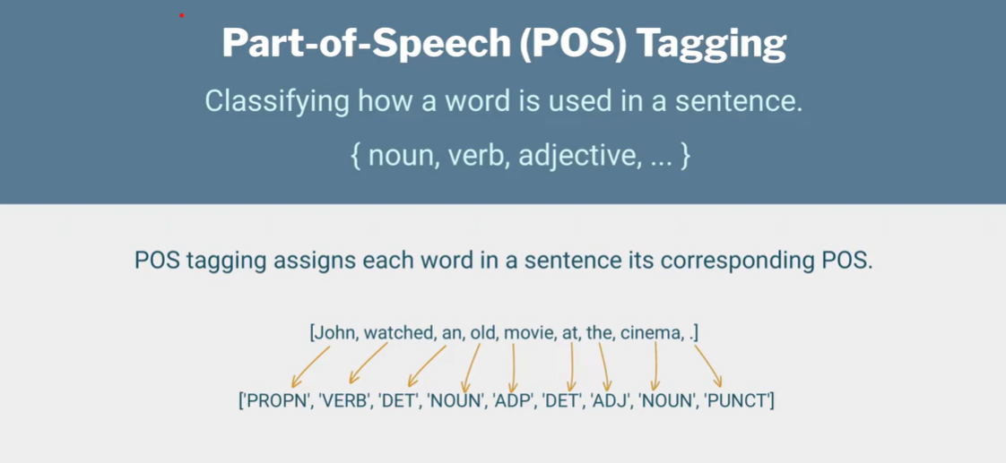

Slide 21
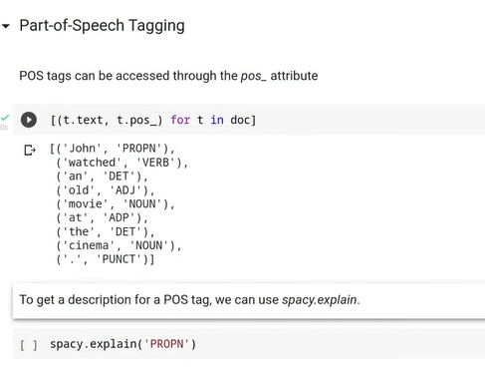
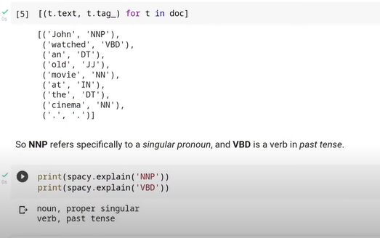
Code implementation of POS Tagging

Slide 22
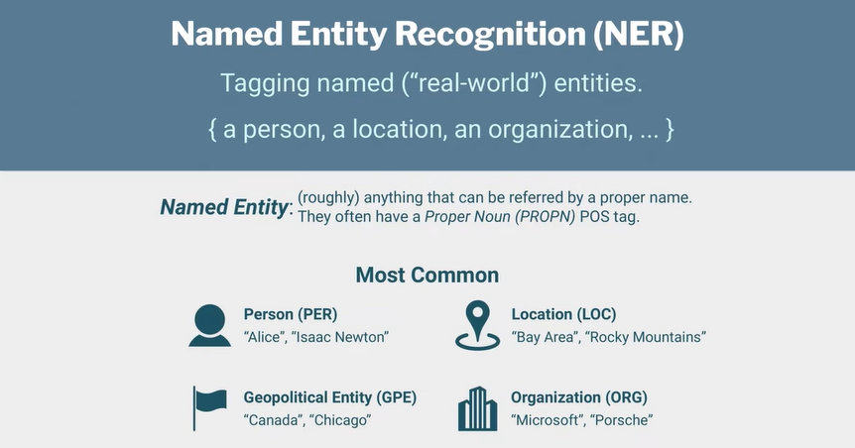

Slide 23
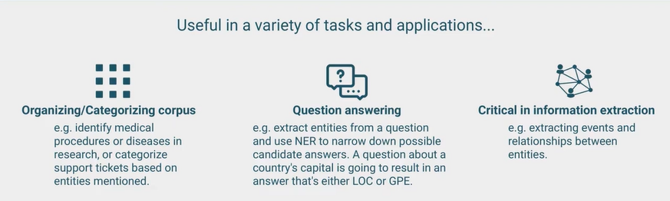
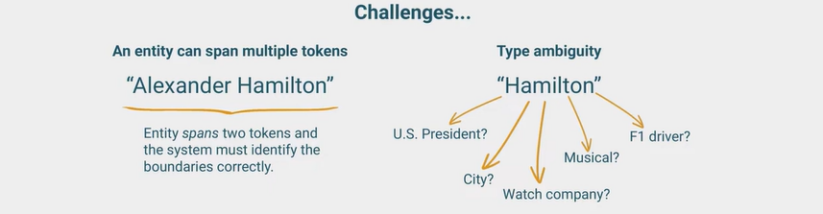
Why NER is useful?

Slide 24
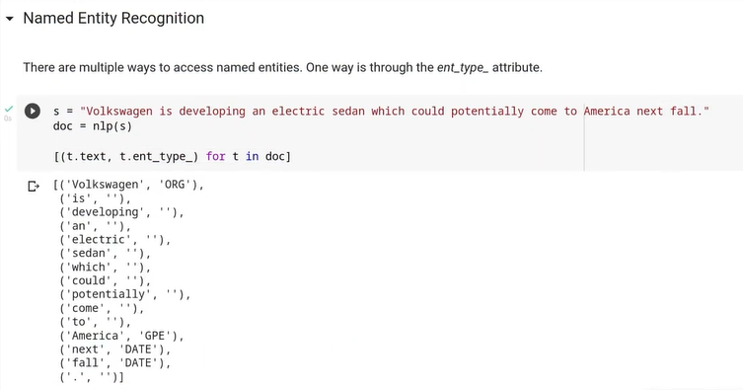
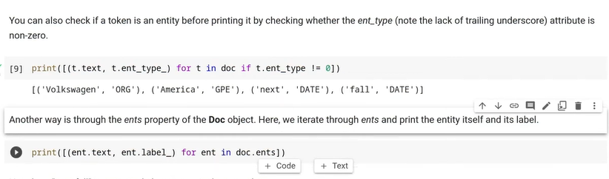
Code implementation of NER Tagging

Slide 25
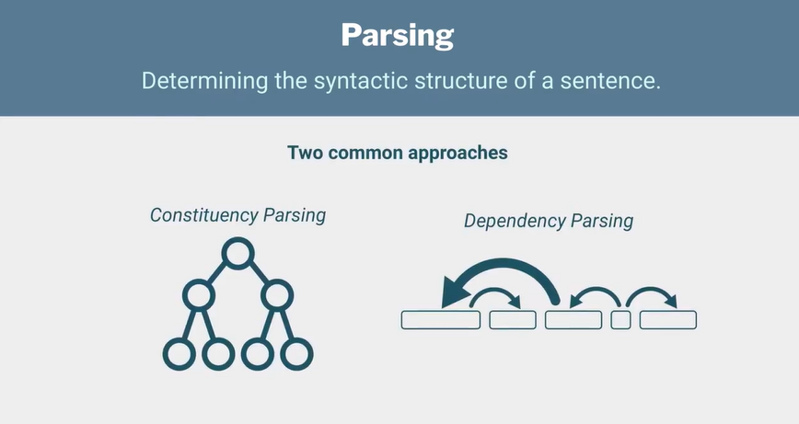

Slide 26
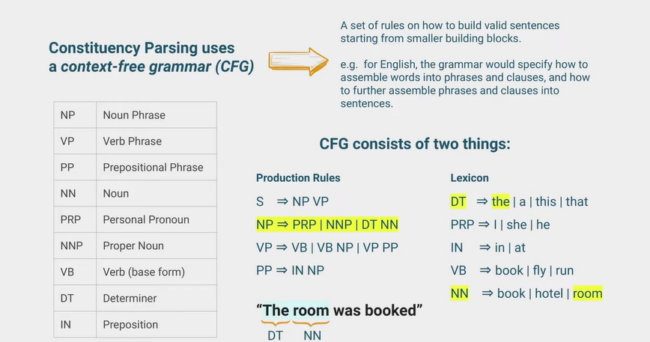

Slide 27
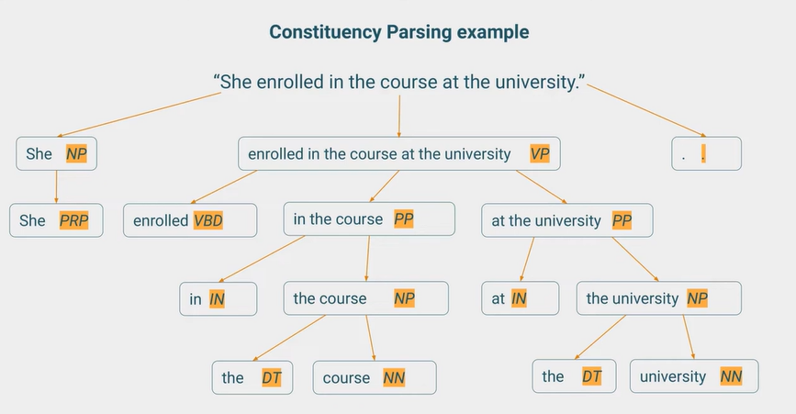

Slide 28
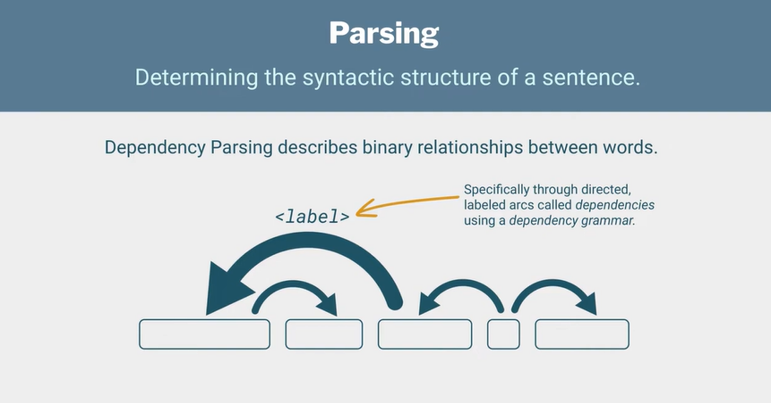

Slide 29
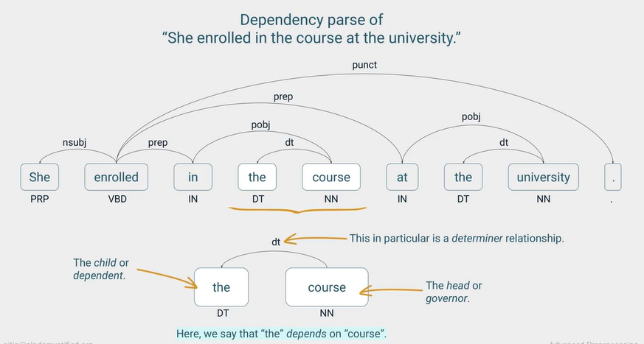

Slide 30
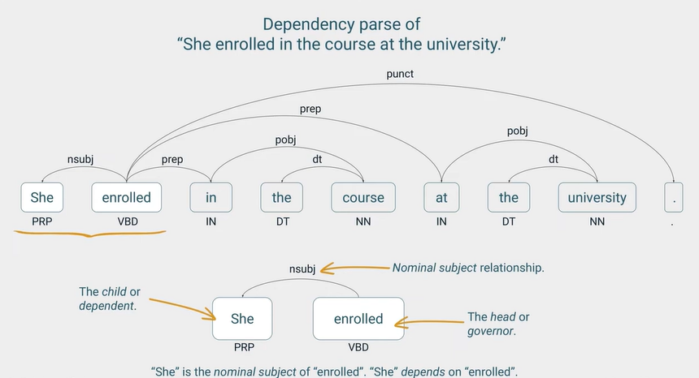

Slide 31
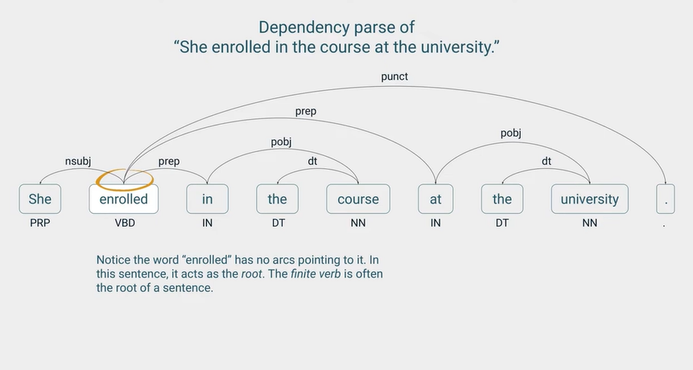

Slide 32
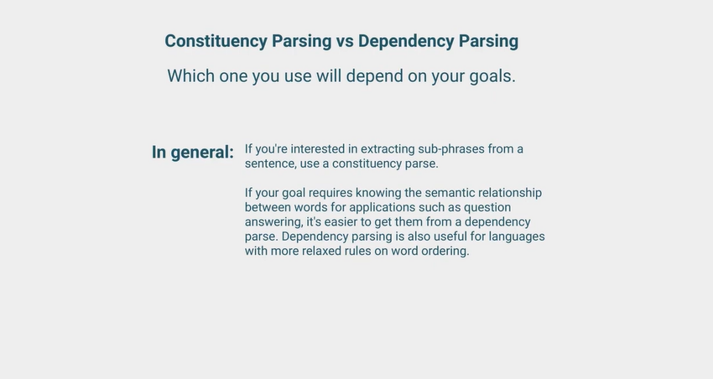

Slide 33
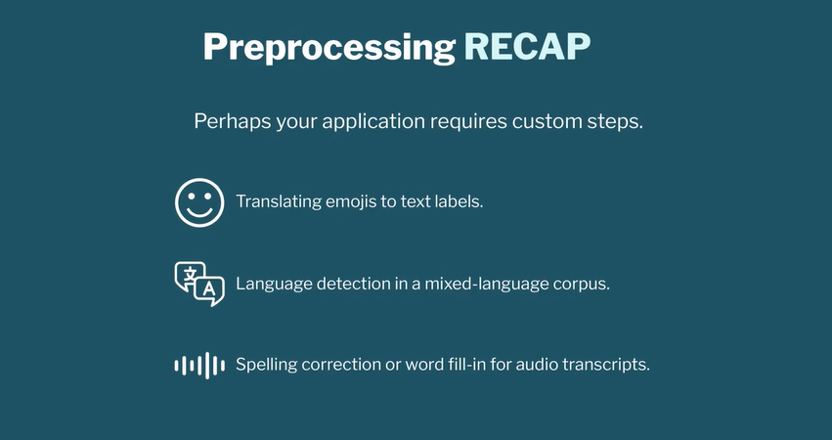

Slide 34
Thank You

